Slide 1
EMPLOYEE Attrition

Slide 2
TABLE OF CONTENTS
Team Information
Introduction of Problem
1
2
Dataset
Analysis
3
4
Results
Solutions
5
6

Slide 3

Team Information
I’m Rana ElBadry
Graduated from Computer Science and Artificial Intelligence Faculty of Helwan University 2024
Instructor in iSchool company

Slide 4
2
Intruduction Of Problem

Slide 5

IBM Company
Cloud Computing:
IBM Cloud offers infrastructure, platform, and software services.
Artificial Intelligence (AI):
Known for Watson, IBM’s advanced AI for natural language processing and machine learning.
Quantum Computing:
A leader in quantum computing with the IBM Quantum platform.
Consulting Services:
Provides IT consulting and digital transformation services.
Enterprise Software:
Develops software for data management, security, and analytics.
Research & Innovation:
A top company for U.S. patents, consistently driving innovation in technology.

Slide 6
OBJECTIVES
The Problem
THE GOAL
In the past year, several talented individuals have departed from our company due to attrition. It's crucial that we address this issue and work towards creating a more fulfilling and rewarding environment for our employees.
To tackle this problem effectively, let's address the issues that are leading to employee attrition.

Slide 7

Employees are the backbone of the organization.
Organization's performance is heavily based on the quality of the employees.
Challenges that an organization has to face due employee attrition are:
Expensive in terms of both money and time to train new employees.
Loss of experienced employees
Impact in productivity
Impact profit

Slide 8
3
Dataset

Slide 9
About Dataset
Uncover the factors that lead to employee attrition and explore important questions such as ‘show me a breakdown of distance from home by job role and attrition’ or ‘compare average monthly income by education and attrition’.
This is a fictional data set created by IBM data scientists.
The data link : https://www.kaggle.com/datasets/pavansubhasht/ibm-hr-analytics-attrition-dataset

Slide 10
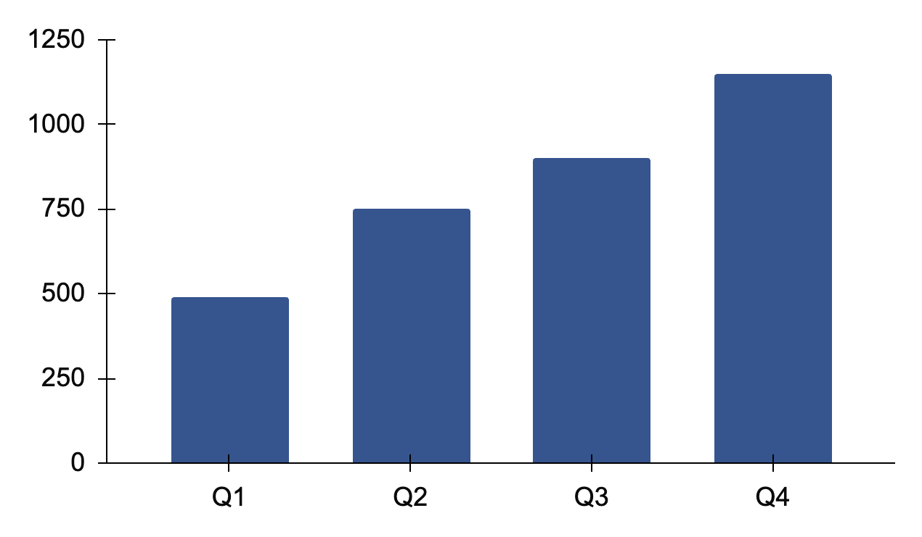
4
Analysis

Slide 11
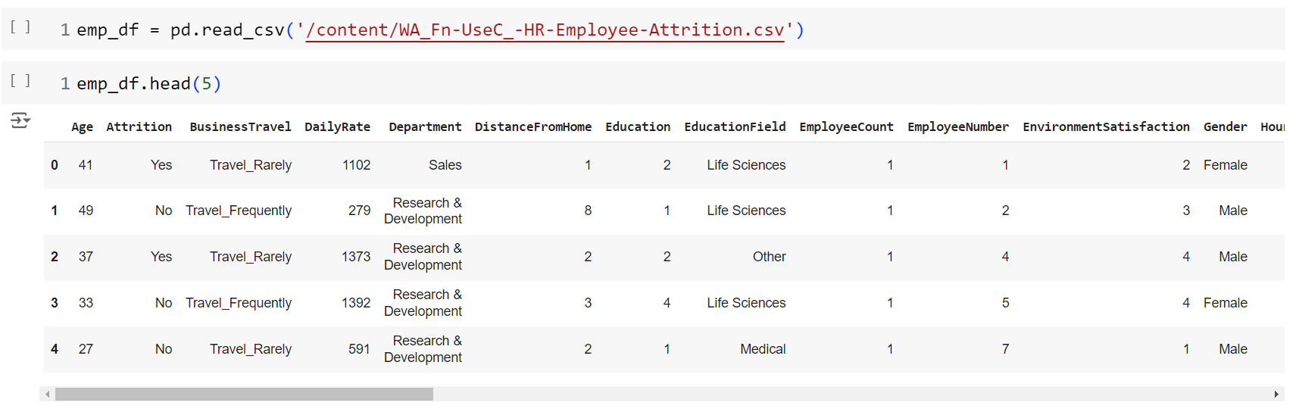

Data Load & Preprocessing
Data has 36 columns x 1470 rows:
(Age,Attrition,BusinessTravel,DailyRate,Department,DistanceFromHome,DistanceFromHome,EducationField,EmployeeCount,
EmployeeNumber,EnvironmentSatisfaction,Gender,HourlyRate,JobInvolvement,JobLevel,JobRole,JobSatisfaction,
MaritalStatus,MonthlyIncome,MonthlyRate,NumCompaniesWorked,Over18,OverTime,PercentSalaryHike,PerformanceRating,
StandardHours,StockOptionLevel,TotalWorkingYears,TrainingTimesLastYear,WorkLifeBalance,YearsAtCompany,
YearsAtCompany,YearsSinceLastPromotion,YearsSinceLastPromotion,YearsWithCurrManager)

Slide 12
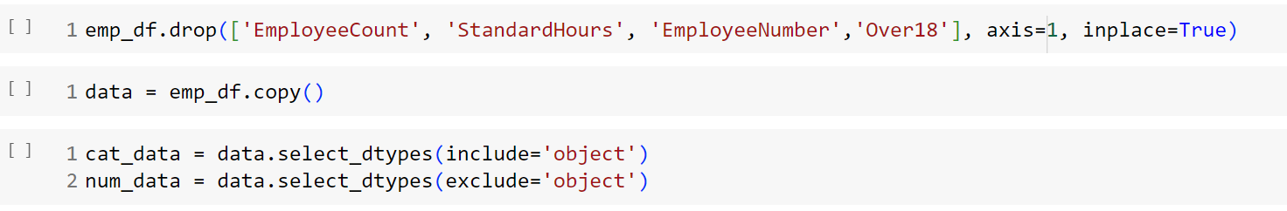
Data Load & Preprocessing
Found that ('EmployeeCount', 'StandardHours','EmployeeNumber','Over18’) need to be dropped so I drop them has no value for analysis.

Slide 13
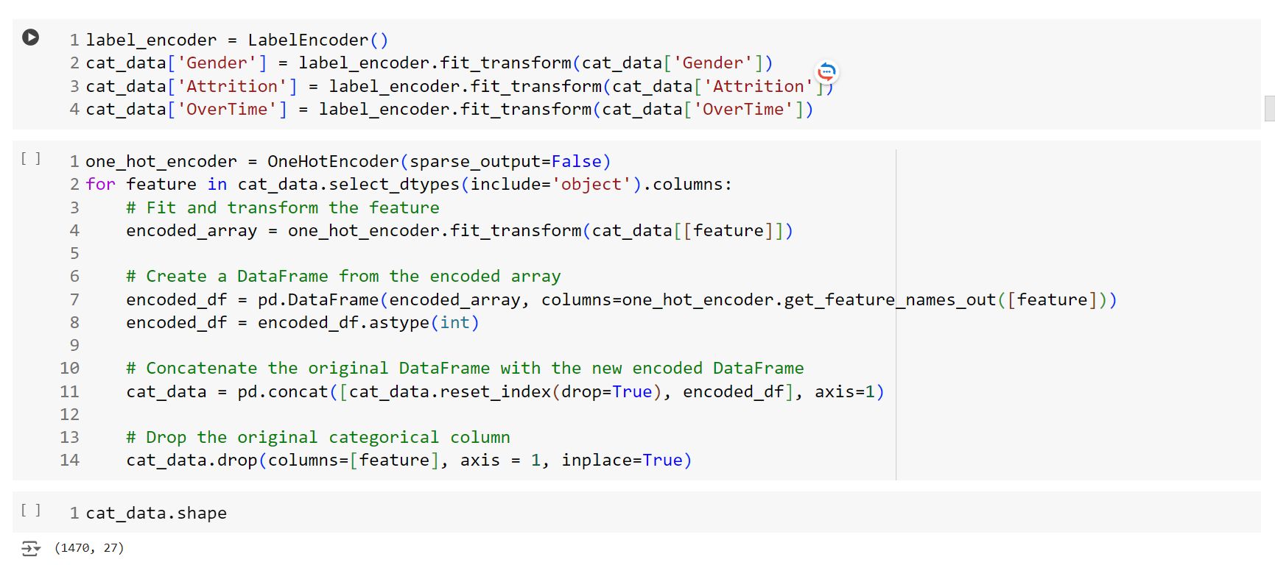
Data Load & Preprocessing
Make encoding for categories data(Gender,Attrition,OverTime)

Slide 14
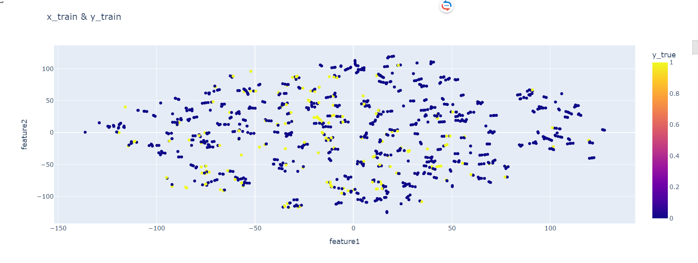
Data Load & Preprocessing

Slide 15
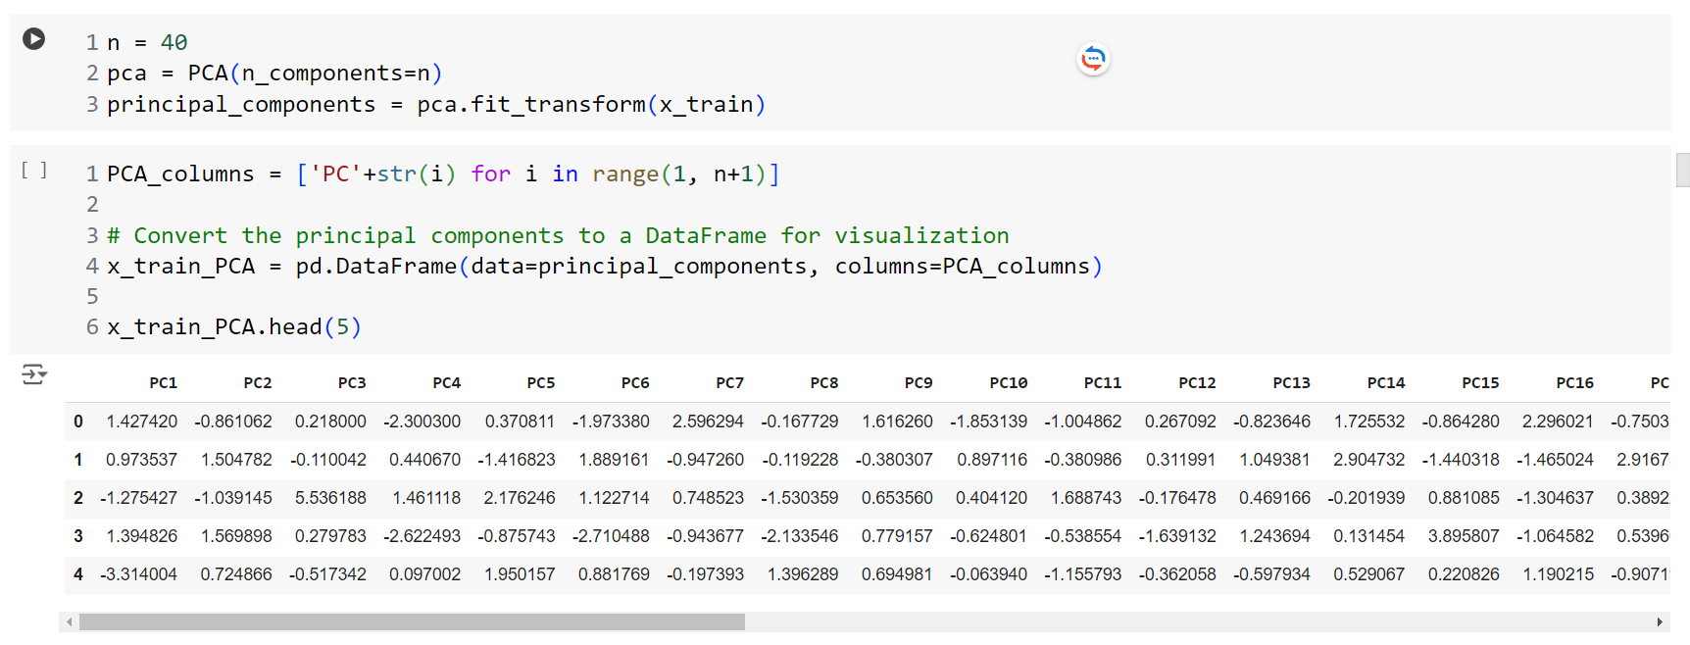
Data Load & Preprocessing
Principal Component Analysis (PCA)
Benefits of PCA:
Noise Reduction: By keeping only the most important components, PCA reduces noise and focuses on the most significant patterns.
Faster Computation: Simplifying the data speeds up machine learning models.
Data Visualization: In datasets with many features,
PCA allows visualization in 2D or 3D by selecting two or three principal components.

Slide 16
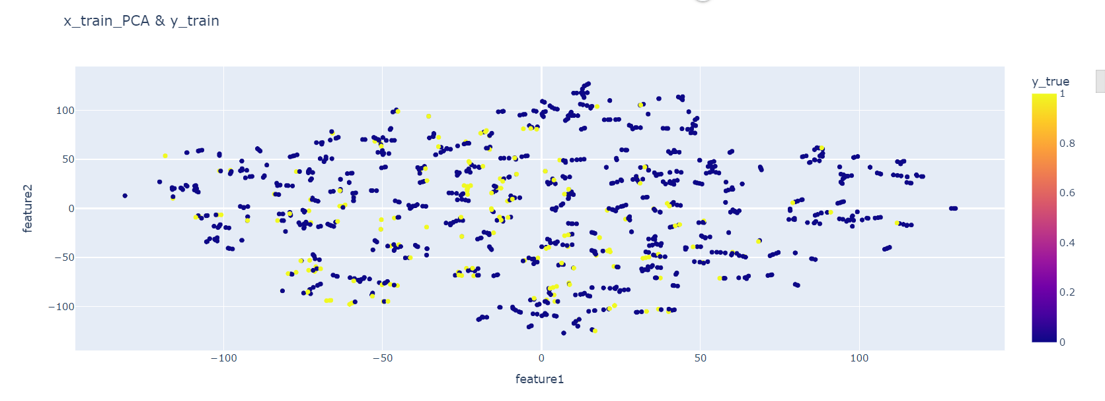
Data Load & Preprocessing

Slide 17
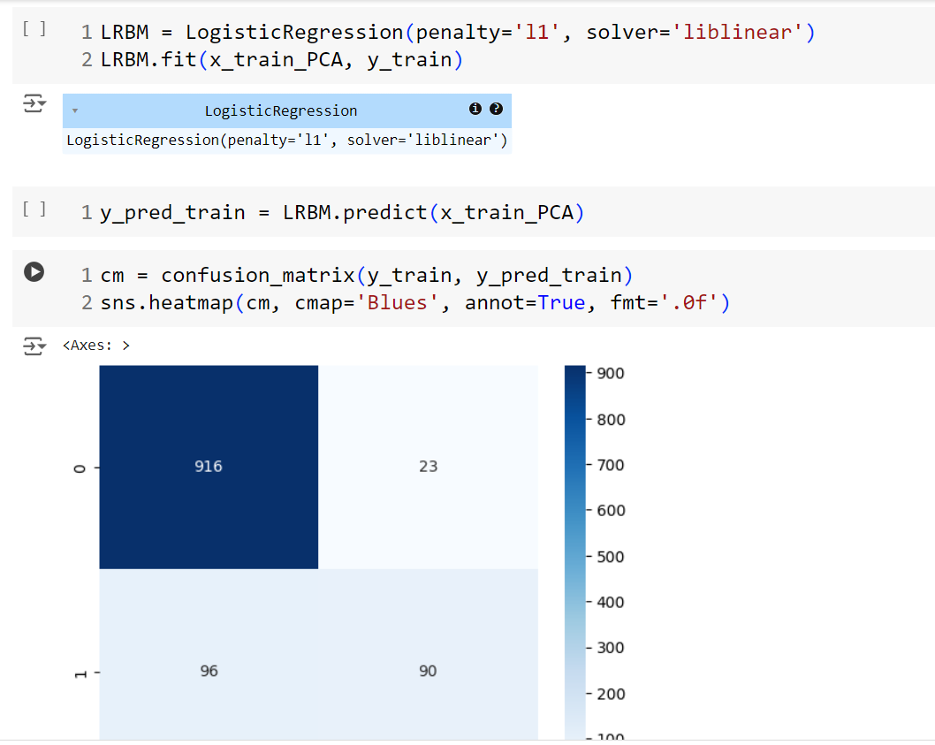
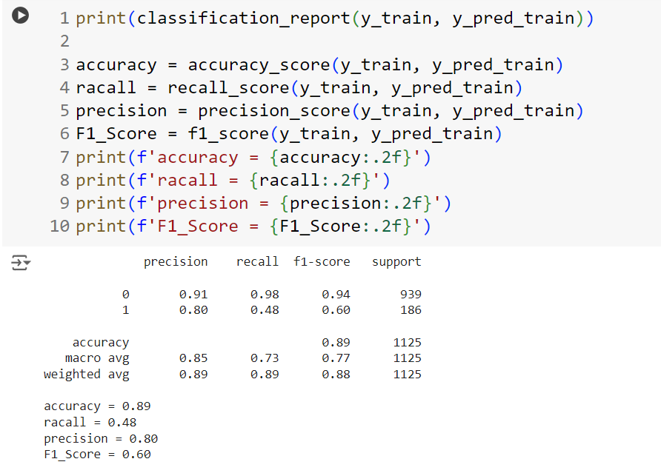
Data Load & Preprocessing

Slide 18
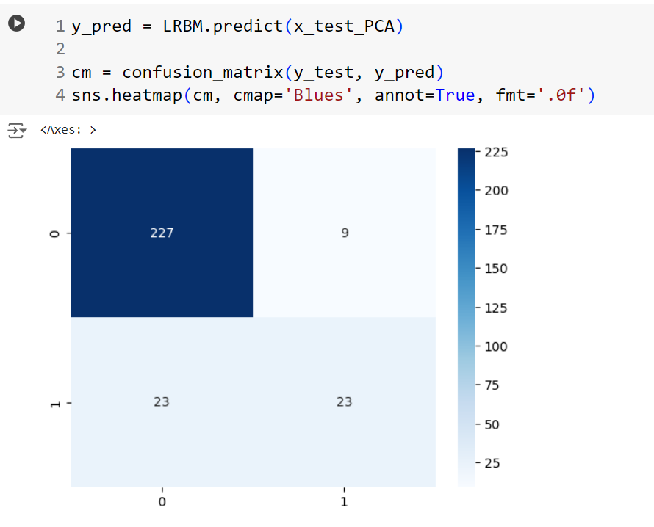
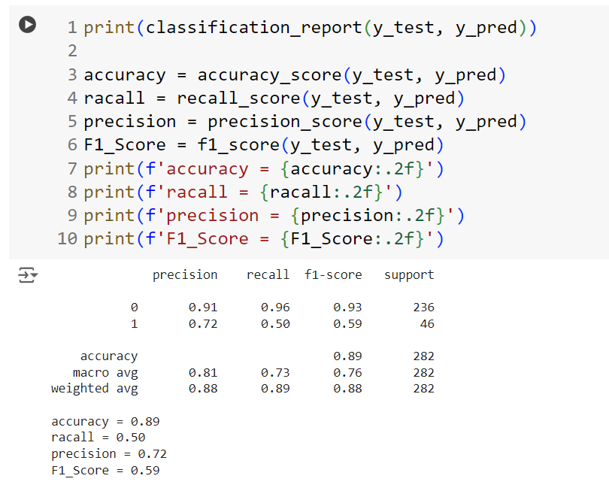
Data Load & Preprocessing
Results :
Of using PCA with data with Logistic Regression as Base Model

Slide 19
Data Load & Preprocessing
I have dropped these columns after PCA 'Education','StockOptionLevel','PerformanceRating','RelationshipSatisfaction','WorkLifeBalance','JobSatisfaction','EnvironmentSatisfaction'

Slide 20
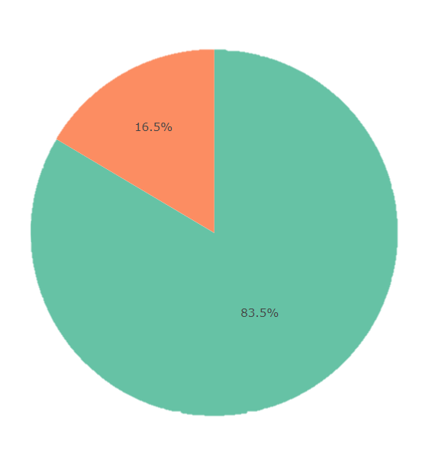
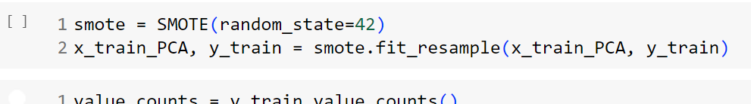
Data Load & Preprocessing
Still that there is unbalance in the data so I use SMOT (Synthetic Minority Over-sampling Technique)
Benefits of SMOTE:
Balanced Dataset: Helps prevent the model from being biased toward the majority class.
Improved Model Performance: Especially useful for classifiers that struggle with class imbalance (e.g., decision trees, SVMs).
Diverse Minority Samples: SMOTE generates diverse samples rather than simply duplicating them, reducing the risk of overfitting.

Slide 21
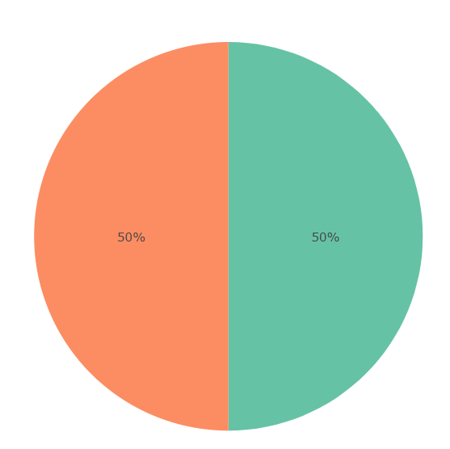
Data Load & Preprocessing
After SMOT

Slide 22
Applied Models
Logistic Regression 81%
Decision Tree Classifier 62%
Random Forest Classifier 81%

Slide 23
Results
5

Slide 24

In the end, we find that the core of the problem is business travel.
We discovered that employees who travel frequently are the most likely to leave the company.
Additionally, we found that younger employees are more likely to leave, as are those with less experience and those who work with a particular manager.
The destination of travel, gender, department (especially research and development), and lack of training in the last 5 years also play a role in employee attrition. These are the main reasons we have identified.

Slide 25
We can implement solutions such as providing 2 hours of free time during the day to make employees feel more relaxed, or organizing activities outside the company, like Sweden does, which has the 4th position in the Global economy.
Another option is to have only 4 working days, as Dubai does, which resulted in a 55% decrease inemployee absenteeism. Employees also reported that they could spend more time with their families, leading to a 71% increase, especially benefiting female employees.
The company can also provide transportation or transportation subsidies to make employees happier and more willing to come to work. Additionally, for travel-related issues, the company can offer more flexibility and provide 2 days off for employees to tour the country, encouraging those who rarely travel to do so. Providing training for employees to enhance their skills can also increase their loyalty to the company.

Slide 26
THANKS!
Does anyone have any questions?

